Slide 1
Notes:
Initial financial support comes from the Sisters of Providence of St. Vincent de Paul.
Sister Pauline Lally is the Honorary Chairperson of PeaceQuest.ca committee.

Slide 2
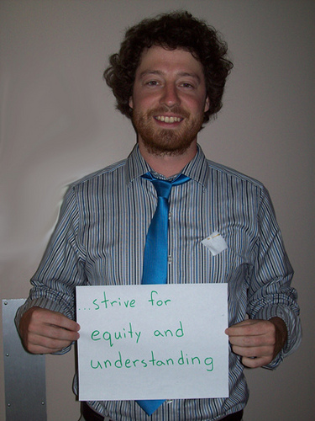
The goal of PeaceQuest is to cultivate Canadians’ deeply held commitment to peace.
Notes:
We hope to stimulate a nation-wide conversation about peace and our country’s role in peacemaking, reconciliation and social justice as we approach the 100th anniversary of the War to End All Wars and Canada’s 150th year as a nation. It is our hope that these concerns will animate people across Canada to undertake PeaceQuest initiatives in their communities between now and 2018.
We want to ask important questions about peace and war:
Should we lament or celebrate war?
What do Canadians want our military to achieve?
How do we make peace so that we can keep peace?
How can people who believe in peace achieve peace?

Slide 3
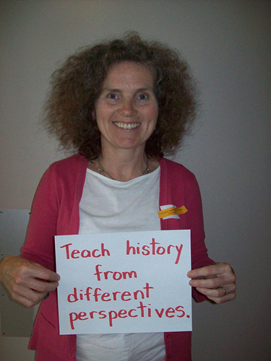
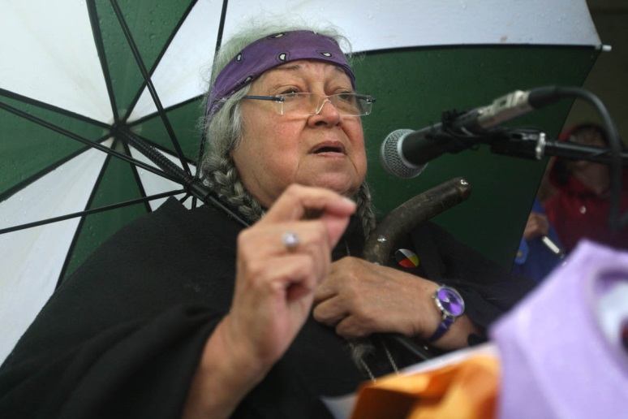
Four Streams:
Education
Faith
Culture
Policy
Notes:
Education -
Gathering and creating curriculum resources for teachers
Publication of an anthology - a collection of original Canadian fiction and non-fiction writing by high profile Canadian poets, novelists, essayists and journalists on themes of peace and war.
Publication of a children’s book - A book of quotations about peace accessible to children ages 6 to 12 years of age.
University common reader - Many universities offer a Common Reading Program as introduction to academic life. Every new undergraduate student is provided with the common reading selection and the university hosts an online forum where students can discuss the book with other new students. PeaceQuest will seek agreement from four Canadian universities to use a book with a strong peace theme as a common reader for first year students.
A contest - PeaceQuest will work with the local school boards to mount a contest for students tied to curriculum in history, social studies, religious studies or other relevant subject areas. The planning committee will determine the structure (an essay, a video, a poster, a blog or other e-project) and the design of the contest (timing, eligibility, judging, etc.)
Faith– Each faith tradition holds and cherishes peace as a value. A multi-faith committee is planning public Peace Pilgrimages journeying from one sanctuary to another to:
~ promote and pray for peace within ourselves, within our relationships, our families, our city, our nation and the world, ~ raise awareness, to learn from others’ perspectives, ~ atone for the violence in our own lives and the world, ~ support each other’s conviction for peace, ~ promote peace as justice and fairness, ~ remember and honour the value of peace and mourn the tragedy of the war, ~ imagine a world without war, ~ be in solidarity with one another, ~ take a collection for the poor so that they might have enough food, clothing and shelter, ~ be peace in the world Vigils of “Grief and Hope” at different cenotaphs connected with a significant event of WWI. In grief, because of the tragic loss of lives and, in hope, because the torch of peace has now been passed on.
Culture - PeaceQuest is excited to work with the entire Kingston arts community on initiatives that will engage the community and will encourage discussion. We encourage artists from all disciplines to get involved by creating or programming peace-themed works during 2014 to 2018. (includes theatre, choirs, book clubs, etc)
Policy – will focus on local, national and international issues of peace and war, to influence governments to commit to the promise of peace. City of Kingston honoured the International Day of Peace on Sept 21, with the unveiling of a monument which reads “Grieving the tragedy of war – committed to the promise of peace.” This stone is placed at the base of an old oak tree in City Park. A newly planted peace tree is marked with the plaque pictured.

Slide 4
John XXIII’s Symbol of Peace

Slide 5
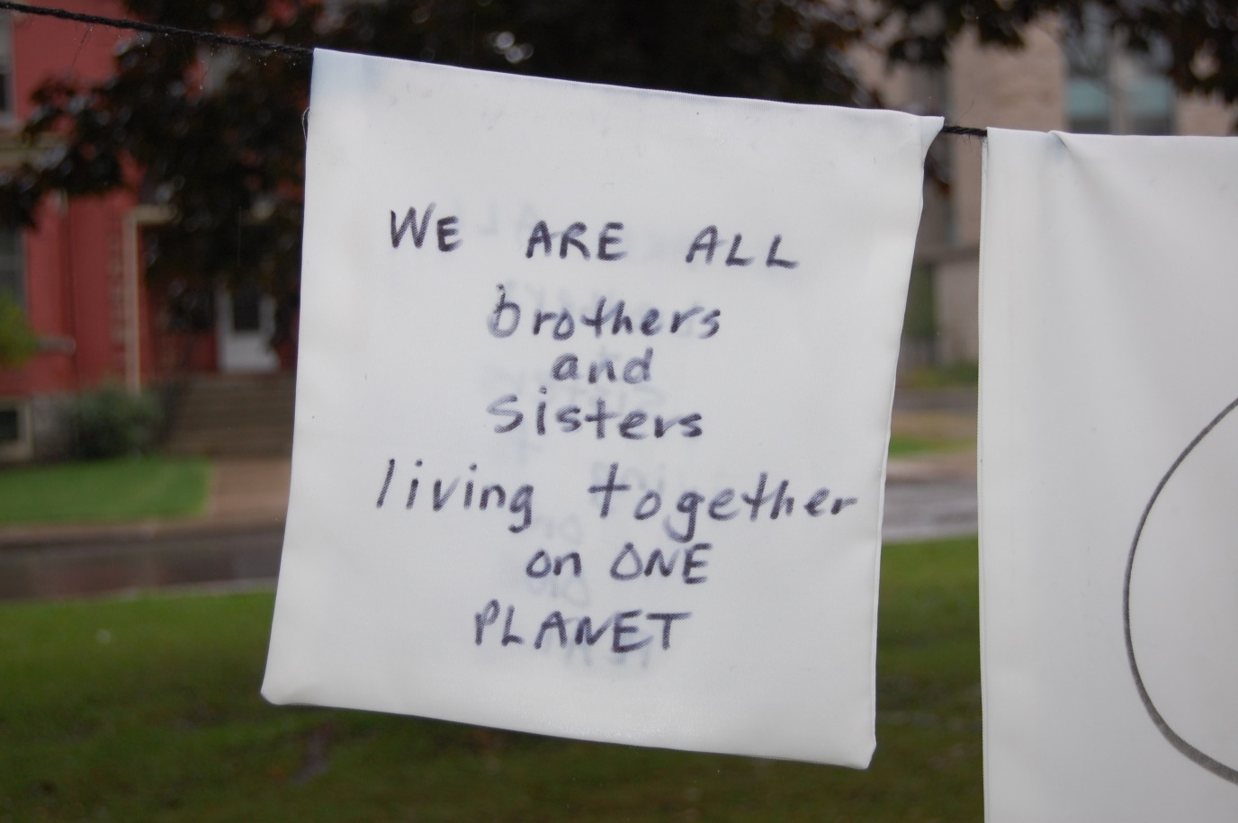
www.peacequest.ca
Notes:
Follow the link to show participants the Peace Quest website

Slide 6
The White Square Activity:
In our quest for peace, we need to…
Notes:
Distribute white squares.
Invite participants to have a conversation with a partner by completing the sentence starter.
Allow 5 – 10 minutes for this, then invite individuals who wish to share their response with the whole group.
If you have a camera: some may choose to write their statement on large white paper and have their photo taken.

Slide 7
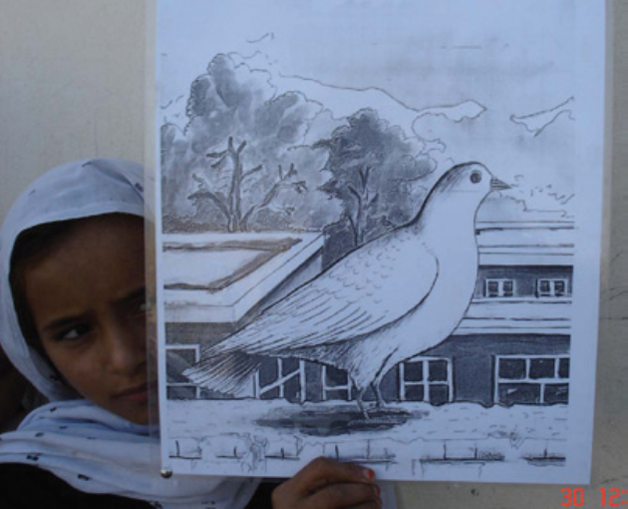
Classroom Resources can also be found on the Religious Education iShare site:
http://ishare.alcdsb.on.ca/reledu/default.aspx
Notes:
Follow the link to show classroom resources for Catholic schools
I support our troops. What’s the relationship of PeaceQuest to Canada’s military?
The members of PeaceQuest are grateful for the service of the Canadian Forces and their families, past and present. We share many similar values and ideas with those that dedicate their lives to the CF. While we recognize that differences exist among Canadians, PQ is interested in building upon the foundation of our common ground.

Slide 8
The next PeaceQuest meeting is:
Thursday, October 24th at 4 pm
at the Limestone Board Office
(Room C)
on Portsmouth Avenue
Elizabeth Neely and Viktoria Barnes
October 11, 2013

Slide 9
My peace, my peace is all I’ve got
That I can give to you.
My peace is all I’ve ever had,
Its all I ever knew.
I give my peace to green and black,
To red and white and blue
My peace, my peace is all I’ve got
That I can give to you.
My peace, my peace is all I’ve got
It’s all I’ve ever known.
My peace is worth a thousand times more
Than anything I’ve own.
I pass my peace around and ‘round
‘cross hands of every hue
My peace, my peace is all I’ve got
That I can give to you.

